Slide 1





By Maeva Ahearn
Rating Places I’ve
Cried

Slide 2



My 5 biggest
stressors
Love life
Work
Bills
Meddling Parents
Allergies

Slide 3

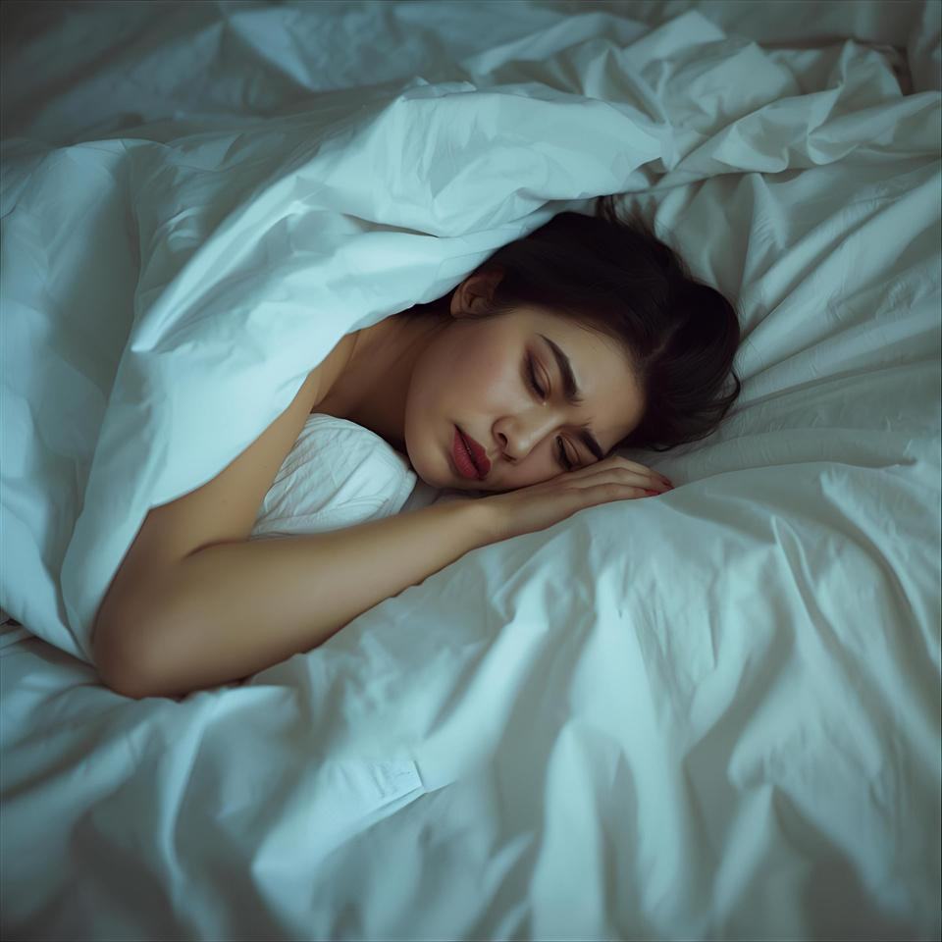
Cry spot #1
In bed, under the sheets
Pros:
No one can see me
It’s cozy
It’s free
Cons:
Have to get up eventually
TV is in the other room
Tears can soak my sheets

Slide 4

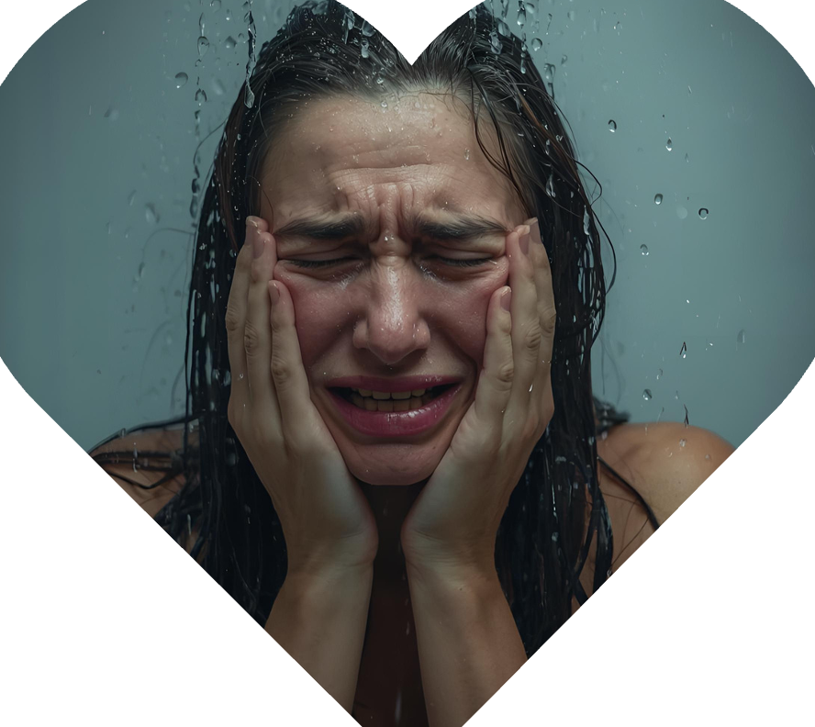
Cry spot #2
In the shower
Pros:
No cleanup required
Feels therapeutic
I’m hidden from the world
Cons:
Fingers become prunes when I emote for too long

Slide 5


Cry spot #3
Artsy Cafe
Pros:
Unlimited coffee
Their cookies are to die for
Cons:
All the stares

Slide 6

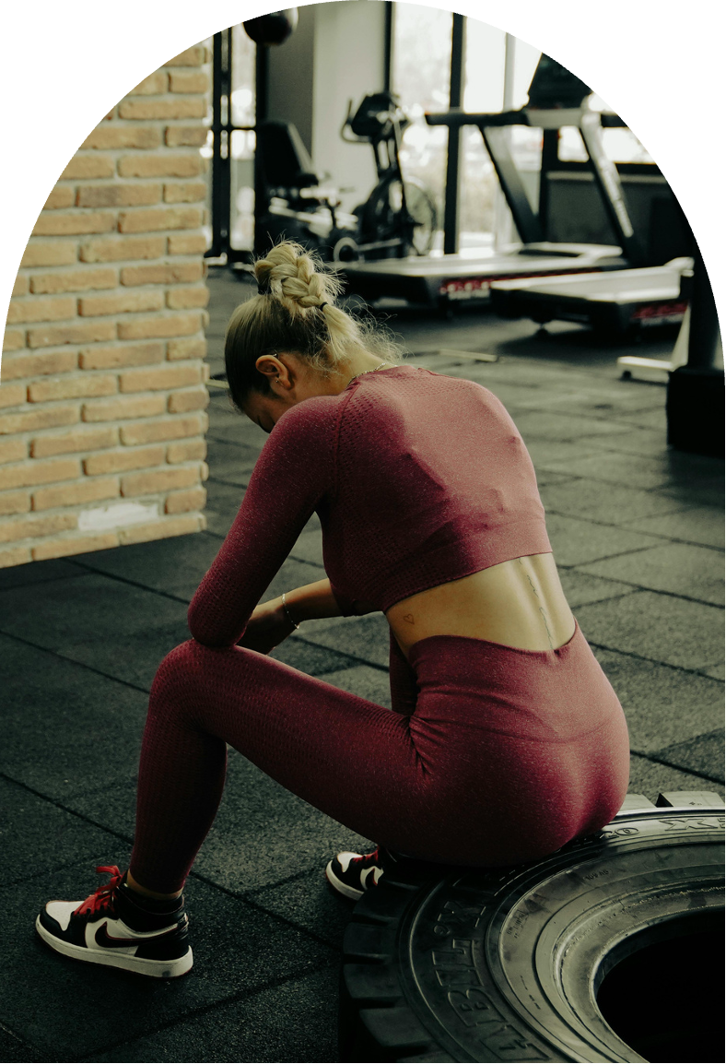
Cry spot #4
Power Fitness 24hr Gym
Pros:
Literally lift the pain away
Is it sweat or tears?
At least it’s healthy?
Cons:
Receptionist now knows I’m going through something

Slide 7


Honorable
mentions
In the
driver’s seat
Westfield Public library
Palm Bay Beach
With the car parked, of course
In the back of the history section
When I’m feeling cinematic

Slide 8





“
Cry now or
crash out
”
later.
— Me

Slide 9




Thank you for bearing with me.
DM for group cry sessions!

Slide 10









Resource Page
Use these in your presentation. Delete or hide this page before presenting.
Fonts
Design Elements / Icons
This presentation template
uses the following free fonts:
TITLES:
Niconne
BODY TEXT:
Libre Baskerville
You can find these fonts online too.
Colors
#FFF2F2
#FAC4DB
#F0758A
#A2085B
#D4B096

Slide 11



Credits
This presentation template is free for everyone to use, thanks to the following:
Pexels, Pixabay, Sketchify
for this presentation template
for the photos, graphics, and elements
Happy designing!

